Slide 1
The s-processes
Philip Adsley padsley@tamu.edu
Texas A&M University
Department of Physics & Astronomy
Cyclotron Institute

Slide 2
Outline (all days)
What are stars and how do they work?
Nucleosynthesis in stars
Going from nuclear data to thermonuclear reaction rates – an experimentalist’s guide

Slide 3
Outline (today)
What are the s-processes?
Sites of s-processes
Nuclear-physics considerations – neutron sources, sinks, branching points etc
Astrophysics considerations – mixing, what’s it got in its pocketsies?

Slide 4
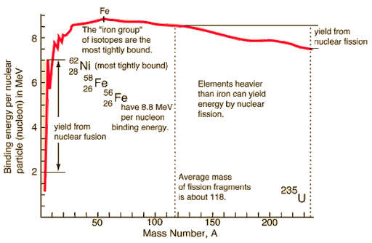
Why did we stop at iron?
We were no longer generating energy through fusion with iron-peak elements
Started nuclear collapse – NSE doesn’t really like to go higher because favours highest binding energy per nucleon
Fusion of charged particles with iron group would require very high temperatures which causes things to fall apart!
If only there were particles which didn’t feel the Coulomb barrier which could interact…
Hyperphysics ☺

Slide 5
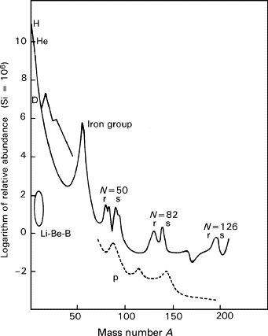
What are the s-processes?
S = slow neutron capture
The capture is slow! Not the neutrons!!
k is 86.2 keV/GK (0.0862 meV/K)
300 K is kT~25 meV
0.3 GK (typical for AGB stars during s-process) kT ~ 25 keV
Encyclopedia of Spectroscopy and Spectrometry
1999, Pages 359-367

Slide 6
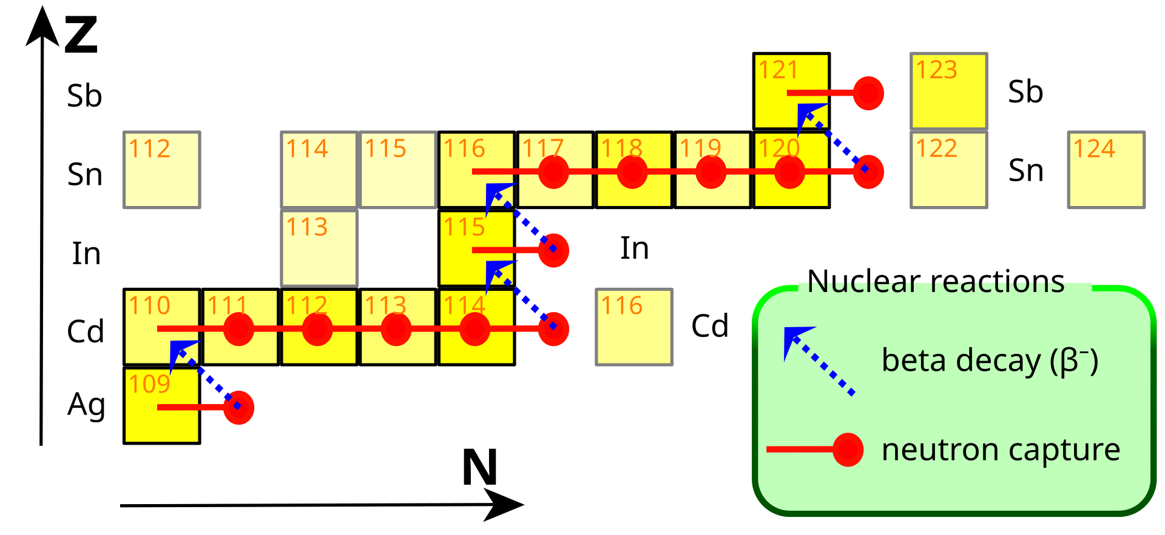

What are the s-processes?
CC BY-SA 3.0, https://commons.wikimedia.org/w/index.php?curid=1581988
S = slow neutron capture
The capture is slow! Not the neutrons!!
The capture is “slow” relative to the β-decay lifetime
Sequential process – capture a neutron until reach an unstable system -> β-decay to stable system
Repeat

Slide 7
Why are there neutrons??
CC BY-SA 3.0, https://commons.wikimedia.org/w/index.php?curid=1581988
Neutrons aren’t stable
Need neutrons to make this happen
Two main opportunities for this:
¹³C(α,n)¹⁶O
²²Ne(α,n)²⁵Mg
OK, but where did we get ¹³C and ²²Ne from?

Slide 8
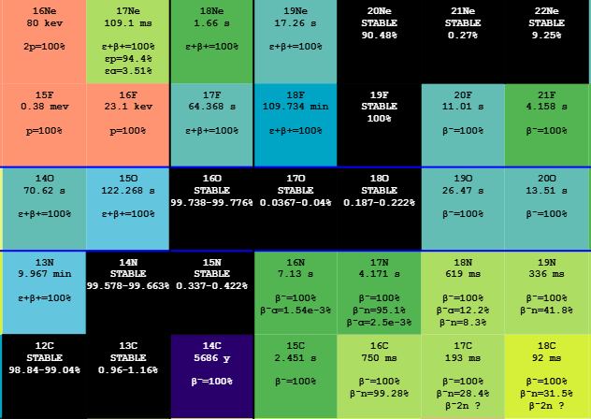
Why are there neutrons??
OK, but where did we get ¹³C and ²²Ne from?
Some stars: CNO cycles from hydrogen burning left ¹³C and ¹⁴N behind
¹³C - fairly obvious the source!
Need more work for ²²Ne:
¹⁴N(α,γ)¹⁸F(β⁺)¹⁸O(α,γ)²²Ne
Other stars make their own

Slide 9
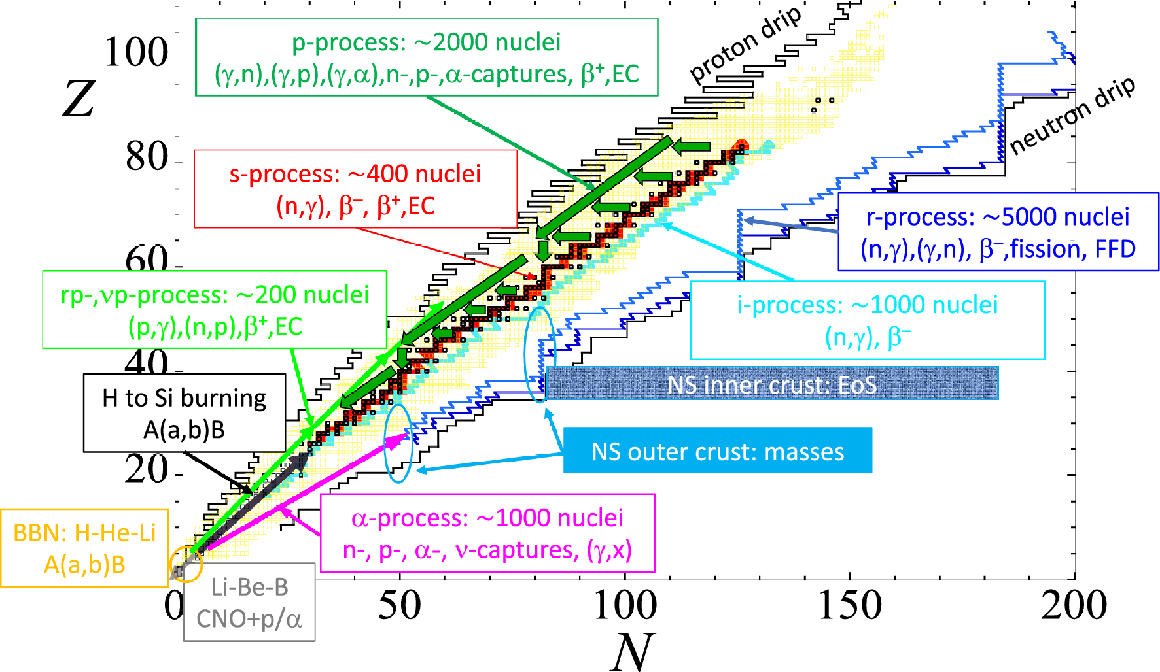
Have neutrons (yay!)
Neutron captures followed by β decays - need to know the rates for these things
Need to have seed nuclei to capture on – mostly Fe-peak from previous supernovae
Need time – it’s slow and so the neutron exposure needs to take place over timescales at least comparable to the neutron-capture lifetime
Goriely EPJA 59 16

Slide 10
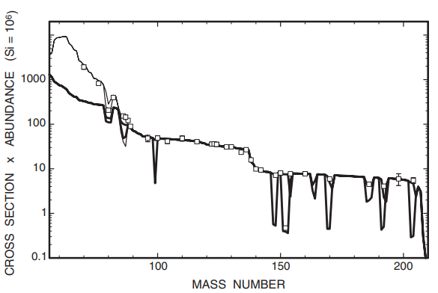
S-process sites
Two known and understood s-processes
Main – thermally pulsing AGB stars
Weak – helium and carbon burning in massive stars
Maybe another – “enhanced”
Kaeppler++ Rev. Mod. Phys., Vol. 83, No. 1
Lumpy bit = weak s-process
Flat bits = main process (I will explain why flat)

Slide 11
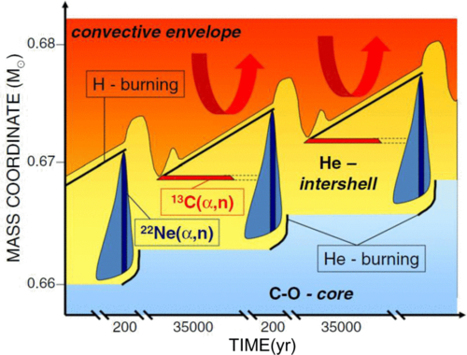
The main s-process
Thermally pulsing AGB stars
CO degenerate core
H/He burning shells on top separated by He intershell
H burning makes more He, into intershell
Gets hotter+denser and thermally pulses (think a moderate explosion)
Wallner++ PRC 93 045803 (2016)

Slide 12
The main s-process
Thermal pulse – helium burning makes ¹²C
Convection of the He intershell
H shell extinguished, He shell burns for a few 1000 years then H-shell reignites
Repeat.
Eventually the convective envelope penetrates the intershell and dredges up material
Wallner++ PRC 93 045803 (2016)

Slide 13
The main s-process
Third Dredge Up (TDU) – of which there are many
Protons from H-rich envelope mixed into the helium intershell
Get ¹²C(p,γ)¹³N(β⁺)¹³C to produce the ¹³C for neutrons
T ~ 90 MK
Wallner++ PRC 93 045803 (2016)

Slide 14
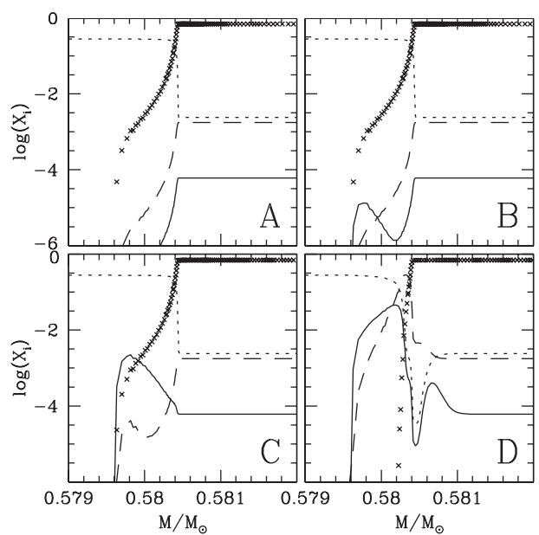

The ¹³C pocket
Straniero, Cristallo and Galina Pub. Astro. Soc. Aust. 26 133
Hydrogen (crosses), ¹²C (short dashed), ¹³C (solid), ¹⁴N (long dashed)
Can see clear production of the ¹³C pocket as protons are mixed in with ¹²C
Also get ¹⁴N in the pocket – leads to ²²Ne!
TDU start
Start of ¹³C production
¹³C pocket developed
¹⁴N production
This axis is ~ radius

Slide 15
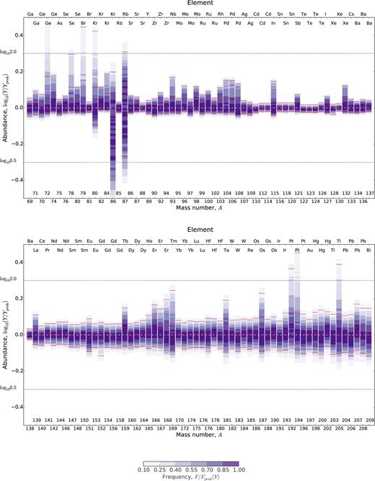
Nuclear physics considerations
(n,γ) capture rates matter
β decay rates matter
Weirdly not as much as you might think
G Cescutti++ MNRAS 478 4101 (2018)

Slide 16
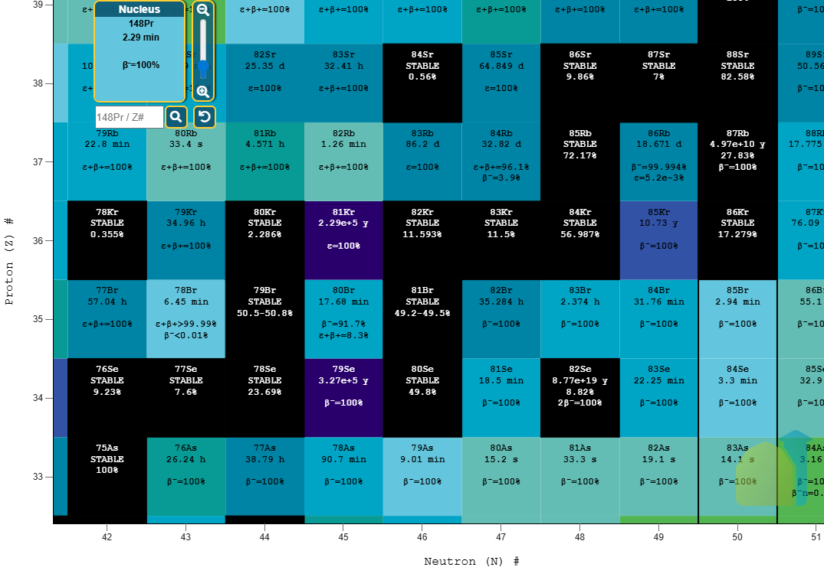
Nuclear physics considerations
(n,γ) capture rates matter
β decay rates matter
Weirdly not as much as you might think
Some cases – ^{80,86}Kr, ⁸⁷Rb abundances modified based on paths
G Cescutti++ MNRAS 478 4101 (2018)

Slide 17
Nuclear physics considerations
(n,γ) capture rates matter
β decay rates matter
Weirdly not as much as you might think
For main s-process – approximately constant cross section * abundance – why?
Steps at closed shells
Kaeppler++ Rev. Mod. Phys., Vol. 83, No. 1

Slide 18
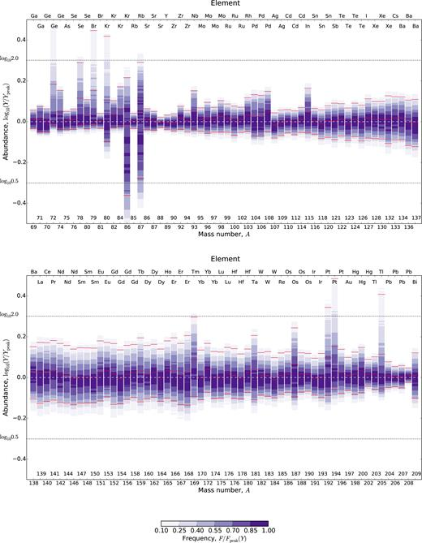
Astrophysics considerations
The ¹³C pocket matters a lot for the main s-process
Less ¹³C = less nucleosynthesis
Example from the same paper showing what happens with ½ the ¹³C
G Cescutti++ MNRAS 478 4101 (2018)

Slide 19
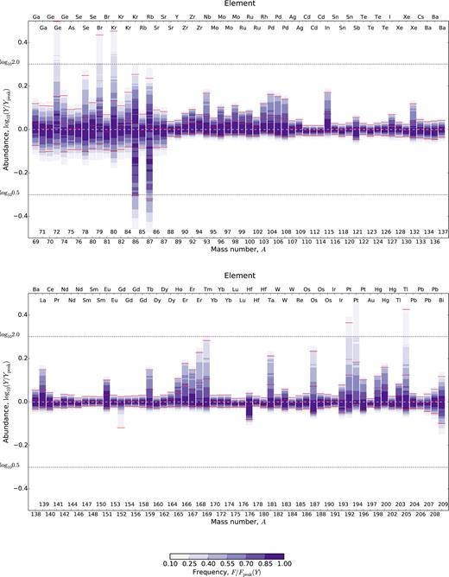
Astrophysics considerations
The ¹³C pocket matters a lot for the main s-process
Less ¹³C = less nucleosynthesis
Example from the same paper showing what happens with 2x the ¹³C
G Cescutti++ MNRAS 478 4101 (2018)

Slide 20
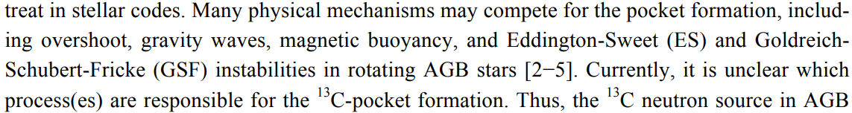
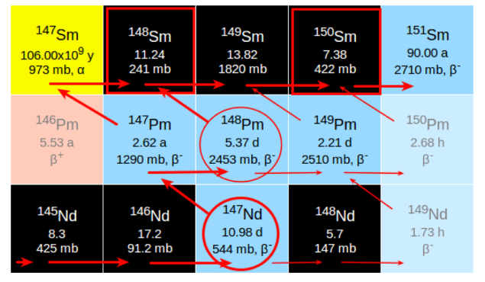
The main s-process
Nan Liu++ XII NIC Conference Proceeding (2014)
Astrophysical uncertainties
Which process actually drives the pocket?!
Magnetic fields might matter (boo)
Branching points are useful – they encode information about neutron exposures and so they allow for tests of astro models

Slide 21
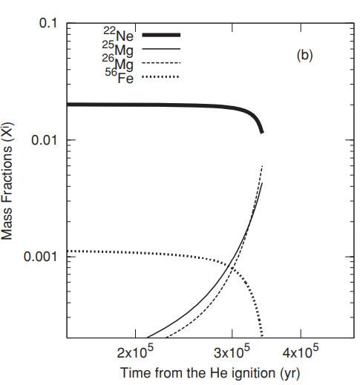
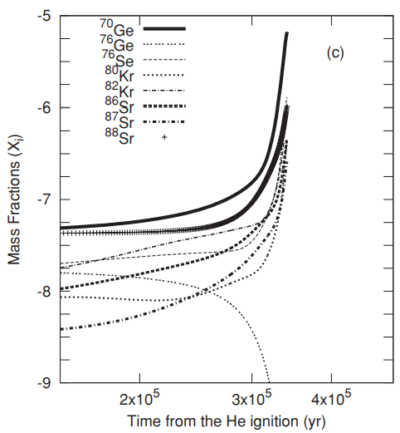
The weak s-process
Weak s-process
Core helium burning T ~ 0.3 GK
Shell carbon burning T ~ 1 GK
Both regions dominated by ²²Ne(α,n)

Slide 22
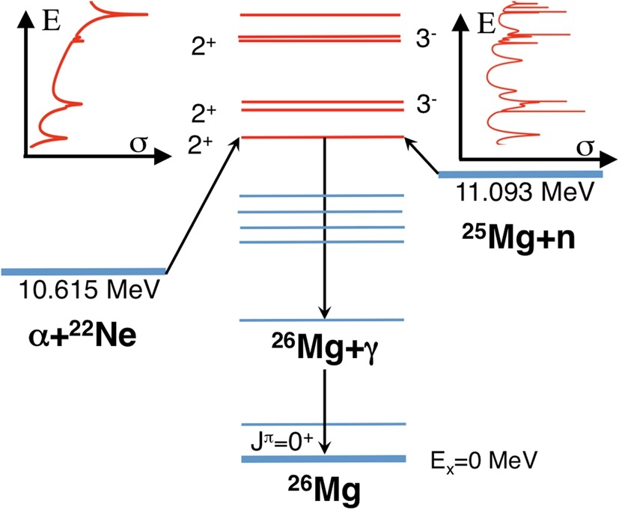
²²Ne + α fusion
Two exit channels – neutron and γ
Efficacy of s-process depends on how much ²²Ne is consumed and produces neutrons
Stronger ²²Ne(α,γ) in He burning = less s-process
Carbon burning: ²²Ne(p,γ) removes ²²Ne, ²²Ne(α,γ) is negligible

Slide 23
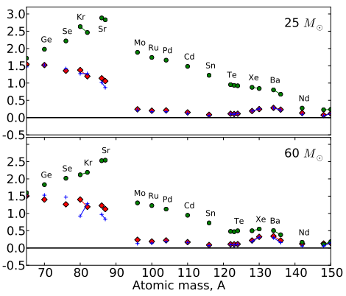
Other important reactions
¹²C(α,γ) – amount of ¹²C left
¹²C+¹²C burning of remaining ¹²C
Making light ions – α vs proton production matters
More protons – make ¹³C via ¹³N but higher temperatures cause ¹³N(γ,p) to beat beta decay
More αs – more ¹³C(α,n) and ²²Ne(α,n) is possible

Slide 24
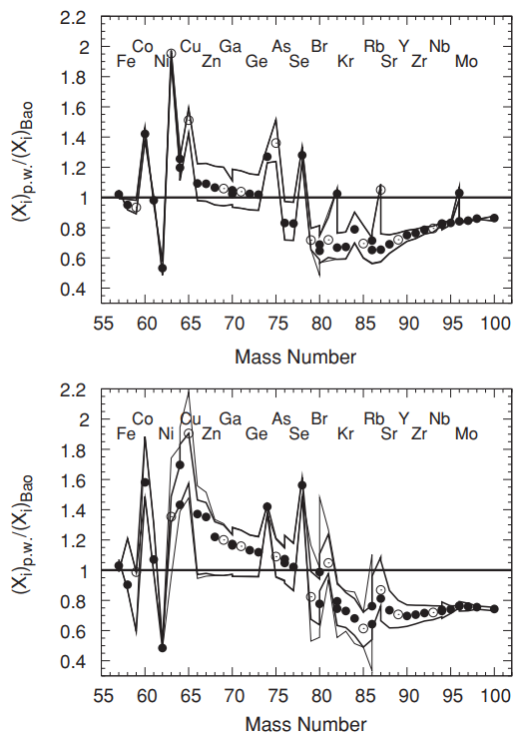
The weak s-process
Nuclear uncertainties
Changing (n,γ) rates changes abundances (as expected)
These plots are updates abundances following updated (n, γ) rates between two different evaluations
Note the overall trend changes and also particular spikes/dips
End of He burning
End of C burning

Slide 25
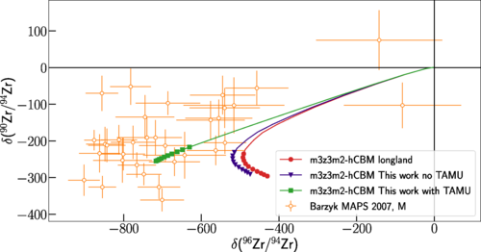
The weak s-process
Nuclear uncertainties
Changing neutrons sources – notably ²²Ne(α,n)²⁵Mg for the weak s-process – matters a lot
Also things like neutron sink reactions (²⁵Mg(n,γ)²⁶Mg is an important one)
PA++ PRC 103 015805

Slide 26
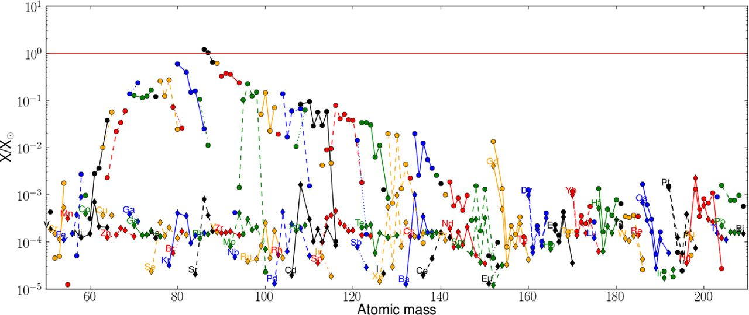
The weak s-process
Astrophysical uncertainties
Mixing is a big one – descriptions of this are hard and computationally expensive (multizone, 3D models)
How much rotation and the origin?
Frischknecht++ MNRAS 456 1803

Slide 27
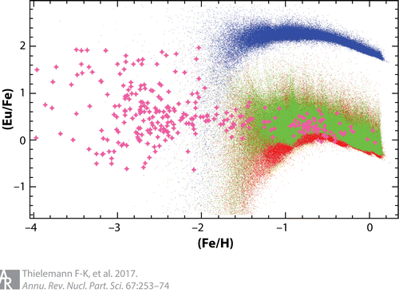
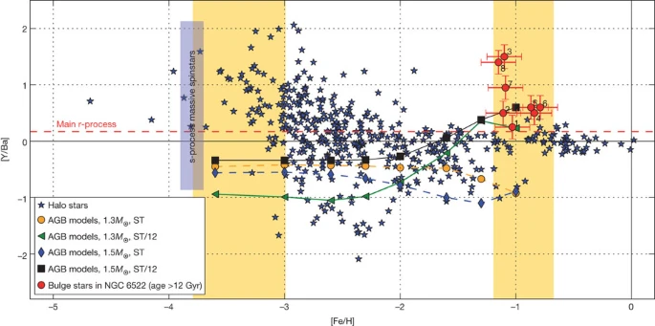
An “enhanced” s-process?
Rapidly rotating metal-poor massive stars may have another s-process
Rapidly rotating = mix ¹³C, ¹⁴N from H-burning shell into He-burning region
Metal-poor = capture on only a small number of seed nuclei so can make higher A elements
Where did this europium come from?
Chiappini Nature 472 454

Slide 28
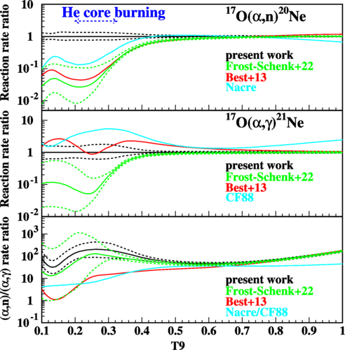
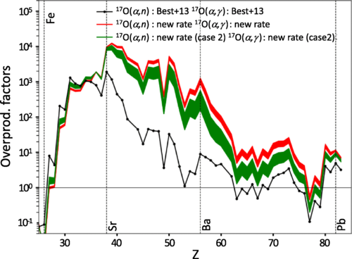
An “enhanced” s-process?
Usual major NP uncertainties
²²Ne(α,n) is the main source
¹⁶O(n,γ) is a major n absorber
¹⁷O(α,n) recycles neutrons
¹⁷O(α,γ) locks neutrons up
Ratio matters for neutron recycling
Can make up to beyond barium, maybe further due to increased neutron recycling
Big astro uncertainties (rotation, mixing prescription, amount of ¹³C)
Hammache, PA, Lamia++, PRL 132 182701 (2024)

Slide 29
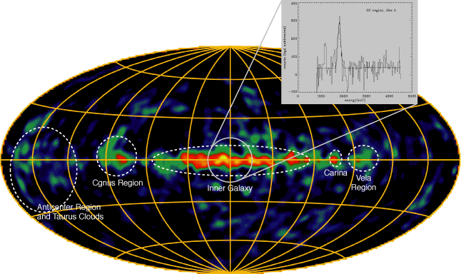
What about lighter elements?
Heavier than iron – neutron capture on iron seed + r-process(es)
Per last lecture – a lot of 10<Z<28 elements are made thought charged-particle reactions
Neutron-induced reactions can matter as well
²⁴Mg(n,γ) bypasses ²⁶Al
²⁶Al+n main destruction path in Wolf-Rayet stars
Other reactions can also be neutron sauces like ¹⁸O(α,n)

Slide 30
Main takeaways
Neutron-capture is vital to produce elements heavier than iron
Need to make neutrons and the number of neutrons available is a major uncertainty
We lose neutrons to poisons and sometimes can recycle them – leads to significant uncertainties as well
Main s-process less sensitive to neutron capture except around shell closures
Weak s-process – neutron-capture rates still matter
There may be an additional s-process but confirmation needed

